Slide 1
Mediator Pattern

Slide 2
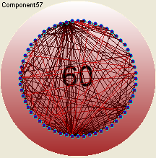
Mutual Dependencies among Objects - Mozilla 1.4.1
Object Oriented Design encourages distribution of behavior among objects.
  Delegation can result in an object structure with many connections between objects.
In the worst case, every object ends up knowing about every other.

Slide 3
Quote from A Mozilla Developer…
“Even though some of us used to work on Mozilla, we have to admit that the Mozilla code is a gigantic, bloated mess, not to mention slow, and with an internal API so flamboyantly baroque that frankly we can't even comprehend where to begin…”

Slide 4
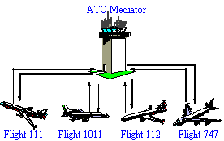

A non-Software Example: ATC

Slide 5
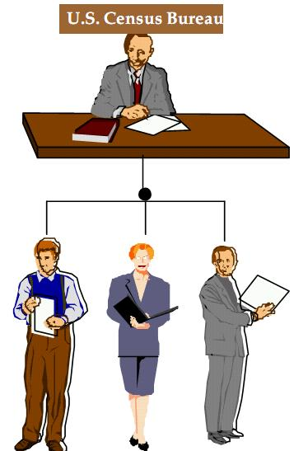
Another Non software example
Master distributes work to identical slaves:
  Computes a final result from the results that the slaves return.

Slide 6
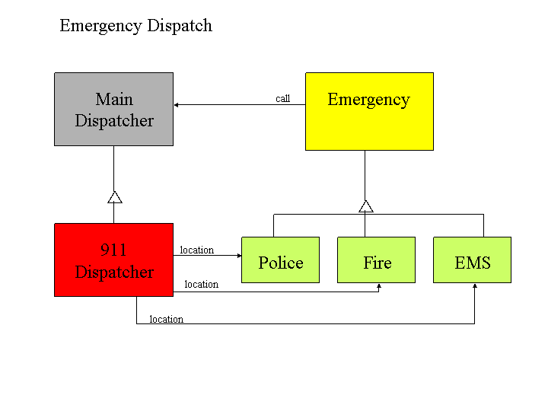
Yet Another Example

Slide 7
Motivation
Object-oriented design leads to distribution of behavior among objects.
  Leads to many connections between objects.
  Lots of interconnections make it less likely that an object can work without the support of others.
  Sometimes the interactions between objects becomes so intense, that every object in the system ends up knowing about every other object.

Slide 8
Case for a Mediator!
Unmediated
Collaboration
collaboratorB
1: op1()
2.1: op2()
2: op2()
collaboratorA
collaboratorC
3: op4()
2.2: op3()
collaboratorD
Mediated
Collaboration
collaboratorB
1.1: op1()
1.5: op2()
1: op()
1.2: op2()
collaboratorA
mediator
collaboratorC
1.3: op3()
1.4: op4()
collaboratorD

Slide 9
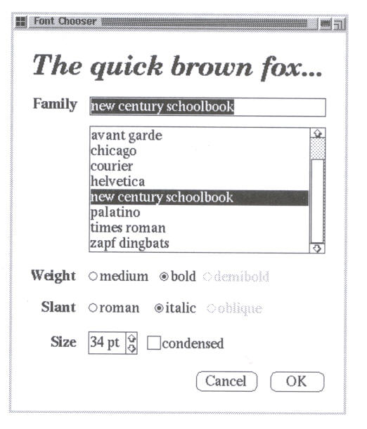
Example- User Interface
The quick brown fox

Slide 10
Font Editing: Mediator Pattern
Client
director
ListBox
director
FormDialog
Director
list
Button
button
field
Entry
Field
director
director

Slide 11
Contrast: Example Coupling Among Classes Without Mediator
Special
ListBox
list
list
button
field
Special
Button
Special
Entry Field
button
field

Slide 12
Font Editing: Mediator Pattern
FormDialogDirector acts as the mediator between the widgets in the dialog box.
  It knows the widgets in a dialog and coordinates their interaction.
  It acts as a hub of communications for widgets.

Slide 13
Mediator Sequence Diagram
aFormDialog
Director
aClient
anEntry
Field
ShowDialog()
aListBox
aButton
Widget
Changed()
Get
Selection()
SetText()
EnableButton()

Slide 14
Font Editing: Mediator Structure
  DialogDirector
ShowDialog()
CreateWidgets()
WidgetChanged(w)
director
  Widget
Changed()
Director.
WidgetChanged(this)
  ListBox
GetSelection()
  FormDialogDirector
CreateWidgets()
WidgetChanged(w)
list
  EntryField
SetText()
field

Slide 15
Font Editing: Mediator Pattern
DialogDirector:
  An abstract class that defines the overall behavior of a dialog.
  Clients call the ShowDialog operation to display the dialog on the screen.
CreateWidgets:
  An abstract operation for creating the widgets of a dialog.
WidgetChanged:
  Another abstract operation, widgets call it to inform their director that they have changed.
DialogDirector subclasses:
  Override CreateWidgets to create the proper widgets, and they override WidgetChanged to handle the changes.

Slide 16
Font Editing Example -Steps
List box informs its director that it’s changed.
Director gets the selection from the list box.
Director passes the selection to the entry field.
Selected font is displayed.

Slide 17
Font Editing Example: Relationship
DialogDirector is an abstract class:
  Defines the overall behavior of a dialog.
Clients call ShowDialog()
CreateWidgets():
  Abstract operation for creating widgets.

Slide 18
Sample Java Code
class FontDialogBox extends Mediator{
private Button ok; private List fontList; private TextField fontName;
private CheckBox latino; private CheckBox latin2; //...more
public FontDialogBox(){
fontList = new ListBox(this);
fontName = new TextField(this);
//...
}
public void display(){
fontList.display();
fontName.display(); //...
}
public void colleagueChanged(Colleague c){
if( c==fontList)
//font_list …
else if(c==fontName)
//fontName...
else if……
}
}
}

Slide 19
Mediator
Encapsulates how a set of objects communicate:
  Defines an interface for communicating with Colleague objects
  Mediator encapsulates the communication.
Mediator promotes loose coupling:
  The objects only know the Mediator
  Keeps objects from referring to each other explicitly.

Slide 20
Mediator Pattern: General Structure
  Mediator
mediator
  Colleague
Concrete
Mediator
Concrete
ColleagueA
Concrete
ColleagueB

Slide 21
Mediator Pattern Participants
Mediator
  defines an interface for communicating with Colleague objects.
ConcreteMediator
  Implements cooperative behavior by coordinating Colleague objects.
Colleague classes
  Each colleague knows its mediator
  Each colleague communicates with its Mediator only, it would have otherwise communicated with another colleague

Slide 22
Mediator Pattern Collaborations
Colleagues send and receive requests from a Mediator object.
The Mediator facilitates cooperative behavior:
  Routes requests between the appropriate colleagues
  Implements a set of rules for message communication.

Slide 23
Mediator: Collaboration
Colleague
OurMediator
Mediator
Colleague
OurMediator
Colleague
OurMediator
Provides a common connection point, centralized behavior management, all with a common interface

Slide 24
Good Points about the Mediator
Centralizes control
  Less chance of miscommunication.
Simplifies object protocols
  Replaces many-to-many interactions with one-to-many interactions between mediator and colleagues
  simple to understand, maintain and extend.
Abstracts how objects cooperate
  Makes it easier to understand the objects in the system, how they interact and how they are structured.
Loose coupling between colleagues promotes Reusability…

Slide 25
Good Points
Limits effects of changes
  Localizes behavior that would be otherwise distributed among many objects
  Changes in behavior require changing only the Mediator class
Decouples colleagues
  Colleagues become more reusable.

Slide 26
Bad Points about the Mediator
Overloaded Mediator:
Numerous subclasses of the Mediator and subclasses of those Mediator subclasses... It's just a horrible cycle from this point on…
Inefficiency:
If there are a relatively small group of objects, it may waste more time as compared to speaking to each other directly.
Might not be a good idea for a relatively small group of objects.

Slide 27
Bad Points cont…
Centralizes control:
  Mediator can become very complex
  With complex interactions, extensibility and maintainability may suffer.

Slide 28
Generic Example
<<Interface>>
IMediator
<<Interface>>
IColleague
+ ColleagueList: List<IColleague>
-mediator
+ RecieveMessage()
+ SendMessage(IMediator)
+ DistributeMessage(IColleague)
+ Register(IColleague)
ConcreteMediator
ConcreteColleague
+ DistributeMessage(IColleague)
for each c in ColleagueList
if c is not parameter Colleague
//don’t send message to the sender
c.RecieveMessage
+ Register(IColleague)
colleagueListAdd(Colleague)
+ RecieveMessage()
+ SendMessage(IMediator)
mediator.DistributeMessage(this)

Slide 29
class MediatorApplicationProgram{
static void main(string[] args) {
//list of participants
IColleague colleagueA = new ConcreteColleague("ColleagueA");
IColleague colleagueB = new ConcreteColleague("ColleagueB");
IColleague colleagueC = new ConcreteColleague("ColleagueC");
IColleague colleagueD = new ConcreteColleague("ColleagueD");
//first mediator
IMediator mediator1 = new ConcreteMediator();
//participants registers to the mediator
mediator1.Register(colleagueA);
mediator1.Register(colleagueB);
mediator1.Register(colleagueC);
//participantA sends out a message
colleagueA.SendMessage(mediator1, "MessageX from ColleagueA");
Cont…

Slide 30
//second mediator
IMediator mediator2=new ConcreteMediator();
//participants registers to the mediator
mediator2.Register(colleagueB);
mediator2.Register(colleagueD);
//participantB sends out a message
colleagueB.SendMessage(mediator2, "MessageY from ColleagueB");
}
}

Slide 31
public interface IColleague{
void SendMessage(IMediator mediator, String message);
void ReceiveMessage(String message);
}
public class ConcreteColleague implements IColleague{
private string name;
public ConcreteColleague(string name) {
this.name = name; }
void SendMessage(IMediator mediator, String message) {
mediator.DistributeMessage(this, message); }
void ReceiveMessage(String message) {
Console.WriteLine(this.name + " received " + message);
}
}

Slide 32
public interface IMediator{
void DistributeMessage(IColleague sender, String message);
void Register(IColleague colleague);
}

Slide 33
public class ConcreteMediator implements IMediator{
private List<icolleague> colleagueList = new List<icolleague>();
void Register(IColleague<t> colleague) {
colleagueList.Add(colleague);
}
void DistributeMessage(IColleague sender, String message){
foreach (IColleague c in colleagueList)
if (c != sender)
//don't need to send message to sender
c.ReceiveMessage(message);
}
}

Slide 34
Related Patterns
Façade
  Mediator defines bi-directional interaction but not façade.
  Facade objects make requests to the subsystem classes but not vice versa.

Slide 35
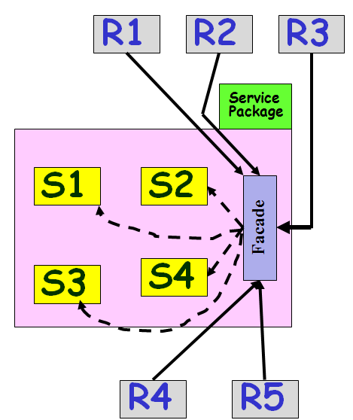
Façade Pattern

Slide 36
Mediator Pattern Example: Game
Player
manager
Dice
manager
Game
Manager
dice
token
board
Token
Board
manager
manager

